Slide 1
1700's: Napoleon Bonaparte
Here is where your presentation begins

Slide 2
Contents of this template
You can delete this slide when you’re done editing the presentation
Fonts | To view this template correctly in PowerPoint, download and install the fonts we used
Used and alternative resources | An assortment of graphic resources that are suitable for use in this presentation
Thanks slide | You must keep it so that proper credits for our design are given
Colors | All the colors used in this presentation
Icons and infographic resources | These can be used in the template, and their size and color can be edited
Editable presentation theme | You can edit the master slides easily. For more info, click here
For more info:
SLIDESGO | BLOG | FAQs
You can visit our sister projects:
FREEPIK | FLATICON | STORYSET | WEPIK | VIDEVO

Slide 3
Table of contents
01
02
03
04
05
06
Section
Section
Section
You can describe the topic of the section here
You can describe the topic of the section here
You can describe the topic of the section here
Section
Section
Section
You can describe the topic of the section here
You can describe the topic of the section here
You can describe the topic of the section here

Slide 4
Whoa!
This can be the part of the presentation where you introduce yourself, write your email…

Slide 5
01
Name of
the section
You can enter a subtitle here if you need it

Slide 6
Do you need longer text?
Mercury is the closest planet to the Sun and the smallest one in the entire Solar System. Contrary to popular belief, this planet's name has nothing to do with the liquid metal. Mercury was, instead, named after the famous Roman messenger god Mercurius
Mercury takes a little more than 58 days to complete its rotation, so try to imagine how long days must be there! Since the temperatures are so extreme, albeit not as extreme as on Venus, Mercury has been deemed to be non-habitable for humans

Slide 7
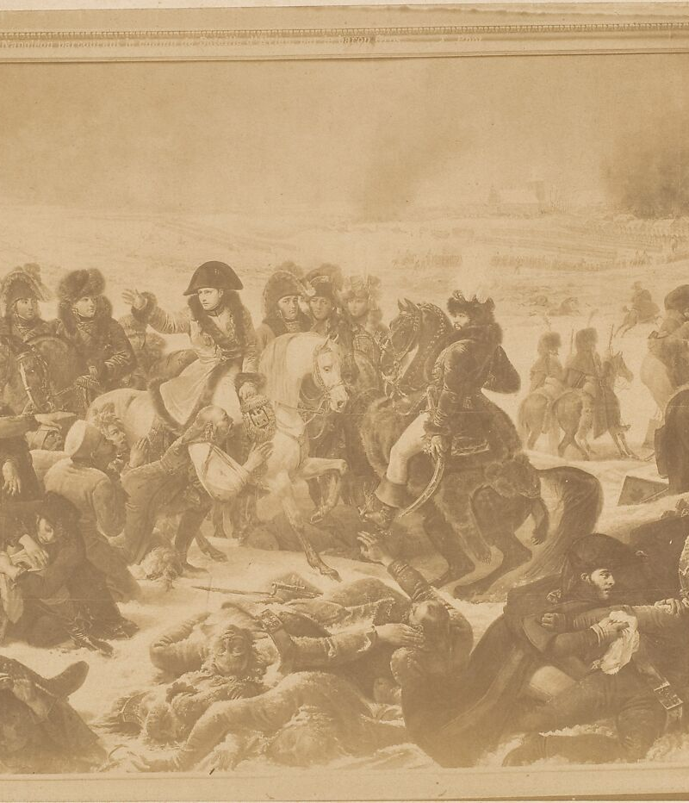
The slide title goes here!
Do you know what helps you make your point crystal clear? Lists like this one:
They’re simple
You can organize your ideas clearly
You’ll never forget to buy milk!
And the most important thing: the audience won’t miss the point of your presentation

Slide 8
You can divide the content
Mercury
Venus
Mercury is the closest planet to the Sun and the smallest one in the Solar System—it’s only a bit larger than the Moon
Venus has a beautiful name and is the second planet from the Sun. It’s hot and has a poisonous atmosphere

Slide 9
Here are three important ideas
Mercury
Venus
Mars
Mercury is the closest planet to the Sun and the smallest of them all
Venus has a beautiful name and is the second planet from the Sun
Despite being red, Mars is actually a cold place. It’s full of iron oxide dust

Slide 10
Divide the content in four ideas
Mars
Venus
Mars is actually a very cold place
Venus has extremely high temperatures
Jupiter
Saturn
Jupiter is the biggest planet of them all
Saturn is a gas giant and has several rings

Slide 11
Reviewing concepts is a good idea
Mars
Venus
Neptune
Mars is actually a very cold place
Venus has extremely high temperatures
Neptune is the farthest planet from the Sun
Mercury
Saturn
Jupiter
Mercury is the closest planet to the Sun
Saturn is a gas giant and has several rings
Jupiter is the biggest planet of them all

Slide 12
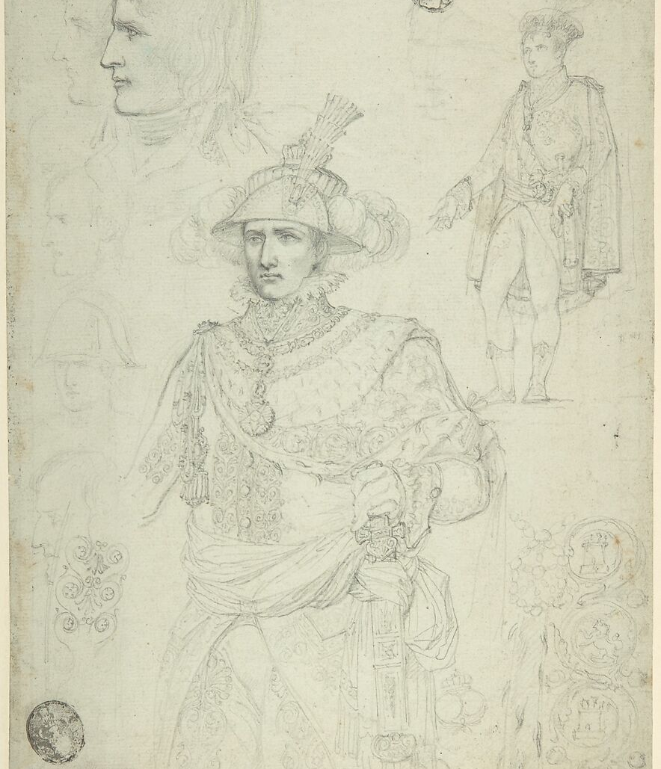
Awesome words

Slide 13
—Someone Famous
“This is a quote, words full of wisdom that someone important said and can make the reader get inspired”

Slide 14
A picture always reinforces
the concept
Images reveal large amounts of data, so remember: use an image instead of a long text. Your audience will appreciate it

Slide 15
9h 55m 23s
333,000
386,000 km
Jupiter’s rotation period
The Sun’s mass compared to Earth’s
Distance between Earth and the Moon

Slide 16
The main power of Napoleon Bonaparte
50%
75%
25%
Military
Political
Leadership
Mercury is the closest planet to the Sun and the smallest of them all
Venus has a beautiful name and is the second planet from the Sun
Despite being red, Mars is actually a cold place. It’s full of iron oxide dust

Slide 17
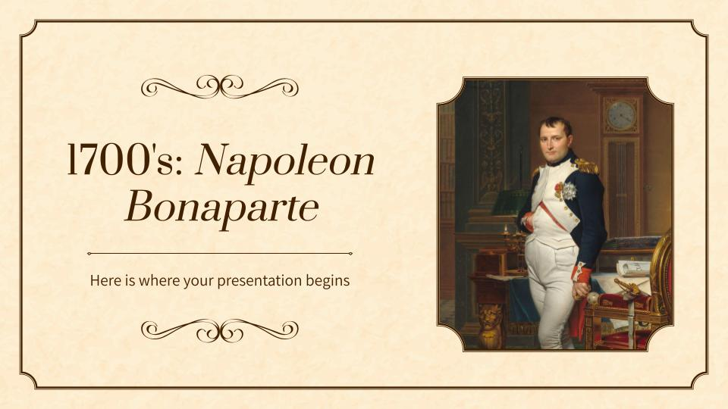
Computer mockup
You can replace the image on the screen with your own work. Just right-click on it and select “Replace image”

Slide 18
Tablet mockup
You can replace the image on the screen with your own work. Just right-click on it and select “Replace image”

Slide 19
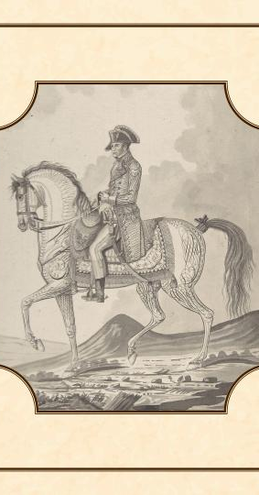
Phone mockup
You can replace the image on the screen with your own work. Just right-click on it and select “Replace image”

Slide 20
Key aspects of Napoleon’s tactics
Use of artillery
Flex formation
Mars is a red planet
Venus is a hot planet
Conquer
Maneuver war
Arm tactics
Mercury is very small
Jupiter is a gas giant

Slide 21
French empire territories
Country | Year conquered | Strategies
Italy | 1805 | Earth is the third planet from the Sun and has life
Austria | 1805 | Saturn is composed of hydrogen and helium
Spain | 1814 | Neptune is the fourth-largest planet in the Solar System

Slide 22
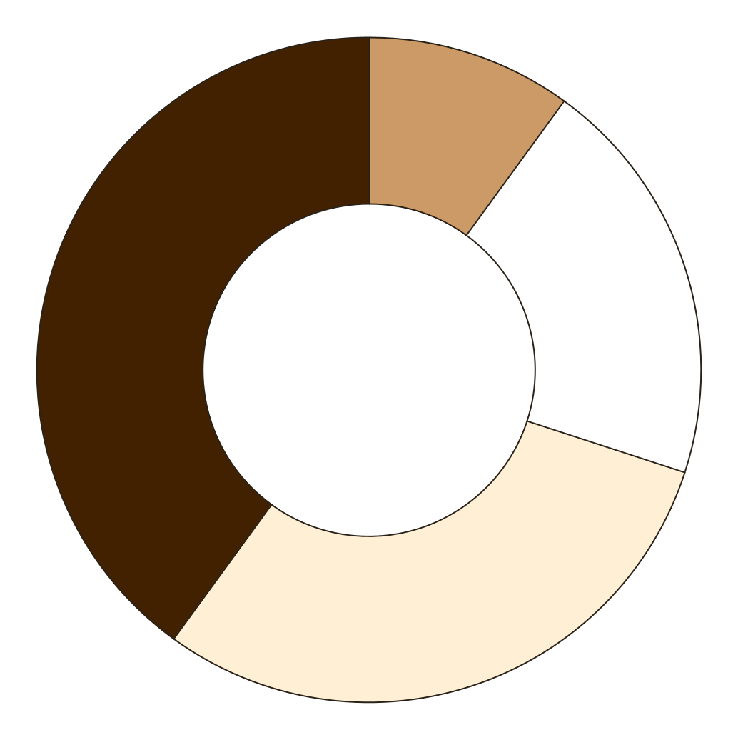
You can use this graph
Musket
Bayonet
Canon
Cavalry
Mercury is quite a small planet
Venus has very high temperatures
Jupiter is an enormous planet
Saturn is a gas giant with rings
Follow the link in the graph to modify its data and then paste the new one here. For more info, click here

Slide 23
Find the correct answer
Directions: Connect to the correct answer
Mercury
It’s composed of hydrogen and helium
Saturn
It’s far away from Earth
Mars
It’s the closest planet to the Sun
Neptune
It’s actually a very cold place

Slide 24
Multiple choice questions
Directions: Please choose the correct answer by marking “X” in the parentheses
Question 1
Which legal code, implemented by Napoleon Bonaparte in 1804, had a lasting impact on legal systems in many countries and emphasized principles of equality before the law, individual rights, and secularism?
( ) The Napoleonic Code
( ) The Justinian Code
( ) The Hammurabi Code
( ) The Twelve Tables

Slide 25
Group discussion
Main role of Napoleon Bonaparte
Discussion regarding the role of Napoleon Bonaparte in constructing the French Empire
Question 1
Question 2
Despite being red, Mars is actually a cold place
Neptune is the farthest planet from the Sun

Slide 26
Short answer questions
Directions: Answer to the following short questions
Which battle is often considered one of Napoleon's greatest victories, where he defeated the Russian forces in 1805?
What was the name of the legal code implemented by Napoleon in 1804 that had a lasting impact in many countries?
What event marked the beginning of the Spanish War of Independence during the Peninsular War (1808-1814)?
After his defeat at the Battle of Waterloo, Napoleon was exiled to which island?
In addition to legal reforms, Napoleon implemented administrative changes. What was the system of regional administration he introduced?
In what year did Napoleon become the Emperor of the French, solidifying his position as the leader of France?

Slide 27
Essay
Directions: Select two of the tactics and write a short answer about them
Answer 1
Answer 2
Tactics
Divide and Conquer
Maneuver Warfare
Artillery Integration
Flexible Formation
Write your answer here ...
Write your answer here ...

Slide 28
Fact-checking exercise
Directions: Divide the class into two groups and let each of them choose a Napoleon’s Bonaparte document from the following list. They should verify the news information using reliable sources.
Group A
Document | Link
Name here | Link here
Name here | Link here
Name here | Link here
Name here | Link here
Group B
Document | Link
Name here | Link here
Name here | Link here
Name here | Link here
Name here | Link here

Slide 29
Thanks!
Do you have any questions?
youremail@freepik.com
+34 654 321 432
yourwebsite.com
Please keep this slide for attribution

